Slide 1
Iterator and Iterable

Slide 2
Iterator
The Java Iterator interface represents an object capable of iterating through a collection of Java objects, one object at a time. The Iterator interface is one of the oldest mechanisms in Java for iterating collections of objects (although not the oldest - Enumerator predated Iterator).
To use a Java Iterator you will have to obtain an Iterator instance from the collection of objects you want to iterate over. The obtained Iterator keeps track of the elements in the underlying collection to make sure you iterate through all of them. If you modify the underlying collection while iterating through an Iterator pointing to that collection, the Iterator will typically detect it, and throw an exception the next time you try to obtain the next element from the Iterator.

Slide 3
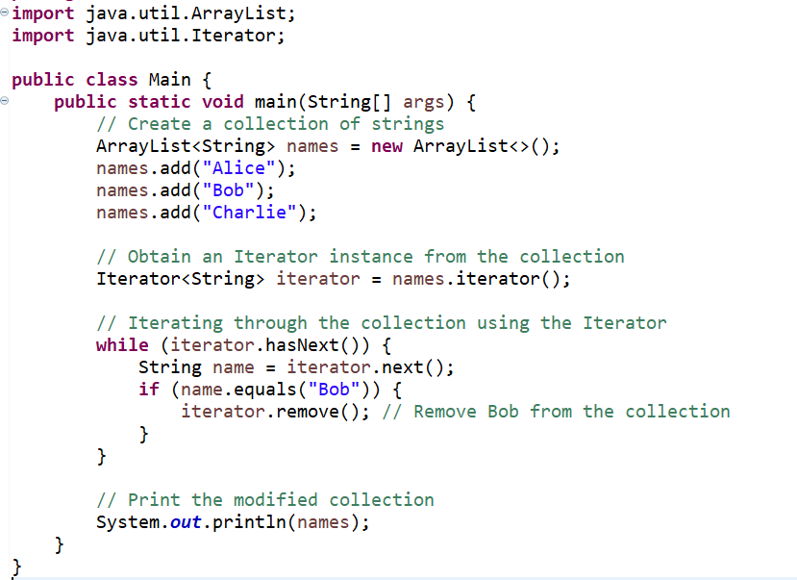

Slide 4
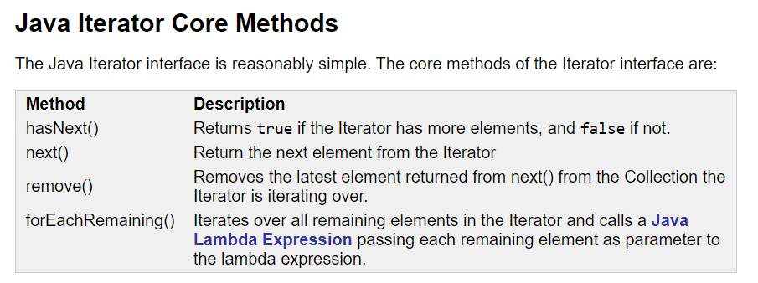

Slide 5
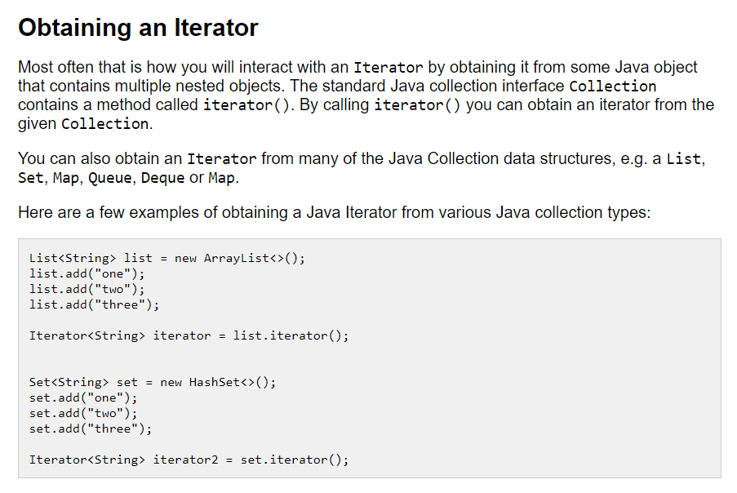

Slide 6
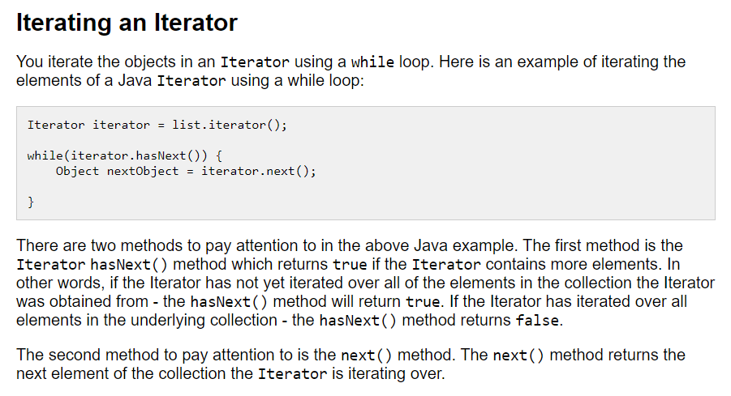

Slide 7
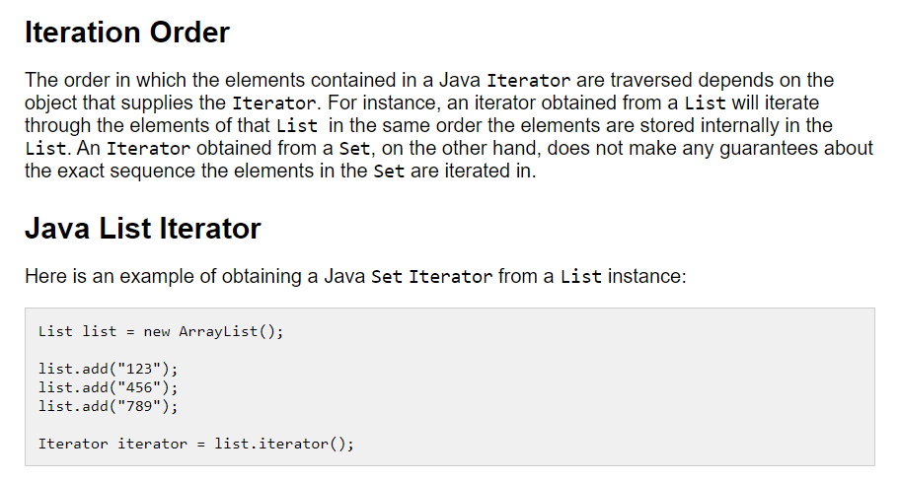

Slide 8
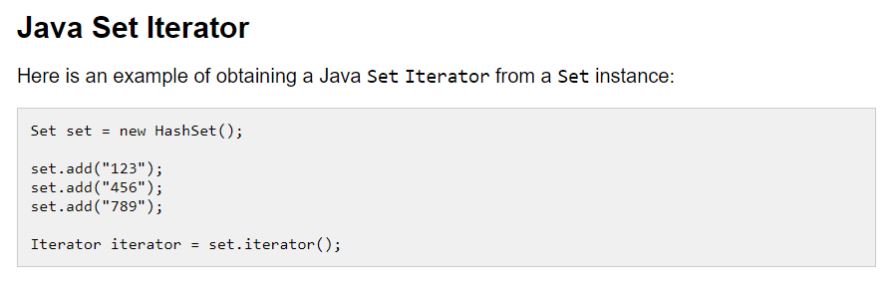

Slide 9
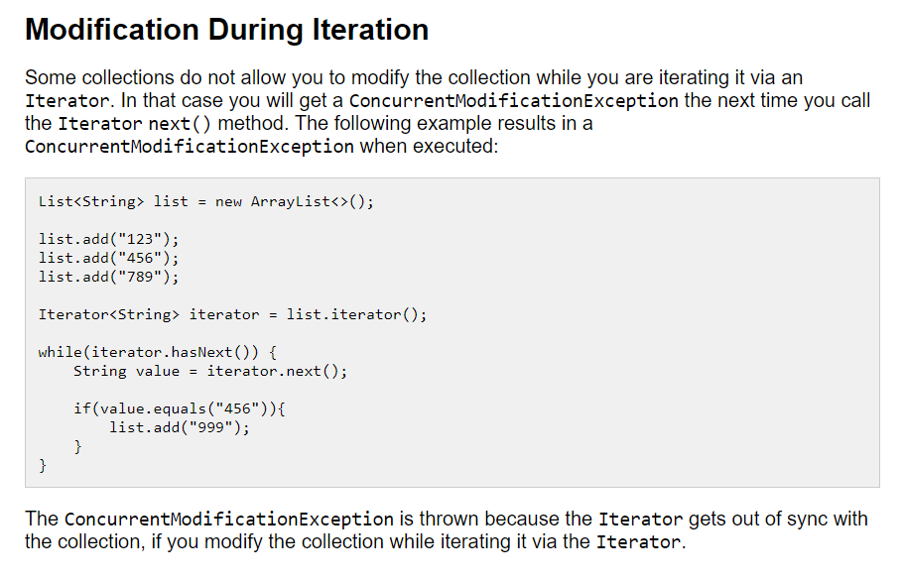

Slide 10
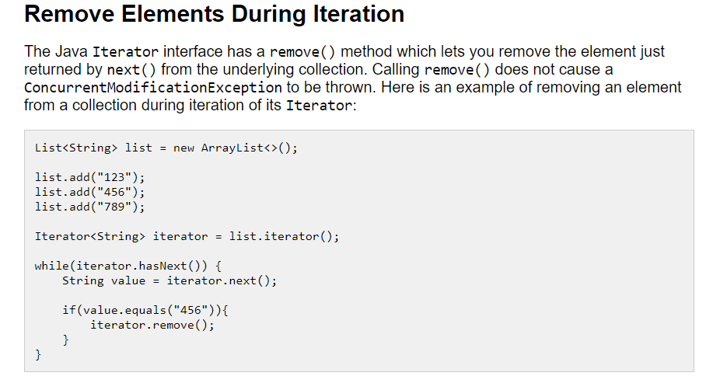

Slide 11
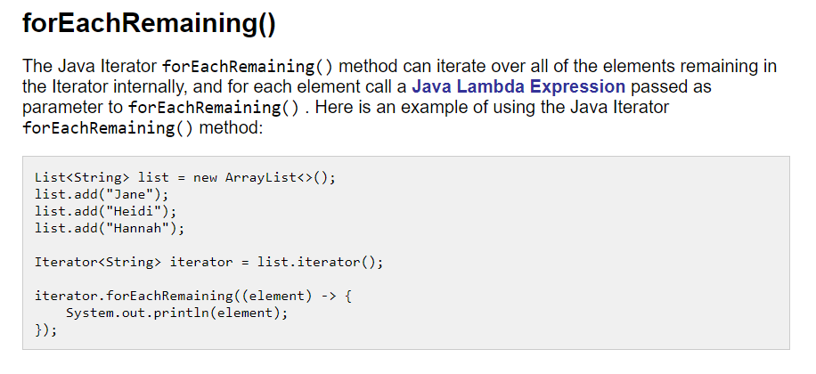

Slide 12
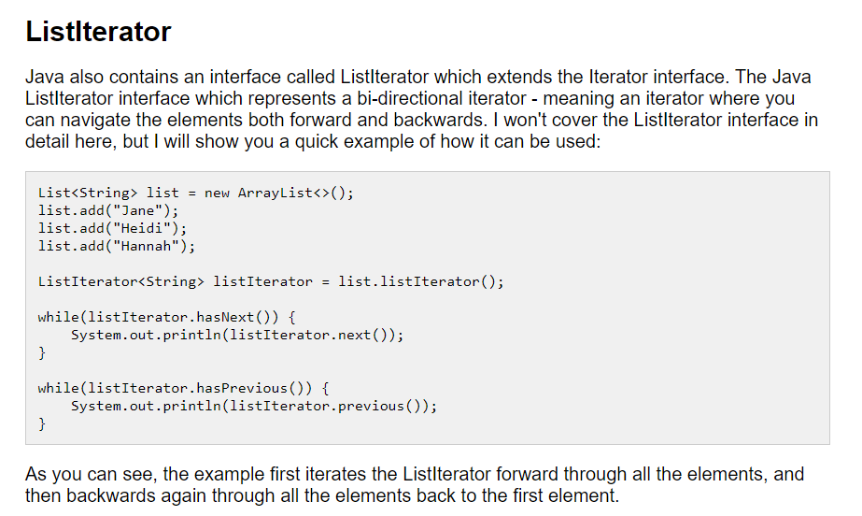

Slide 13
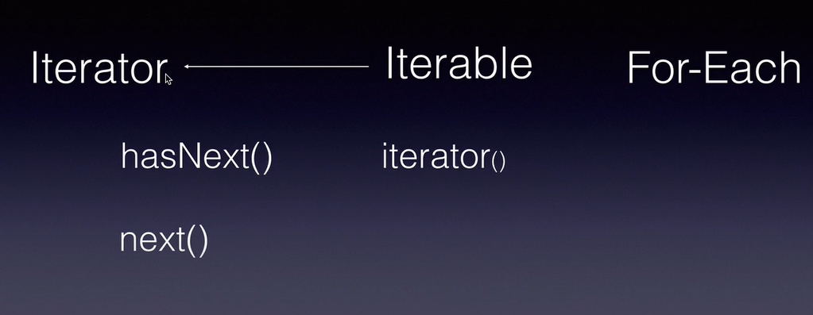
Iterable interface

Slide 14
The Java Iterable interface represents a collection of objects which is iterable - meaning which can be iterated.
This means, that a class that implements the Java Iterable interface can have its elements iterated.
We can iterate the objects of a Java Iterable by :
obtaining a Java Iterator from the Iterable,
or by calling the Java Iterable forEach() method.

Slide 15
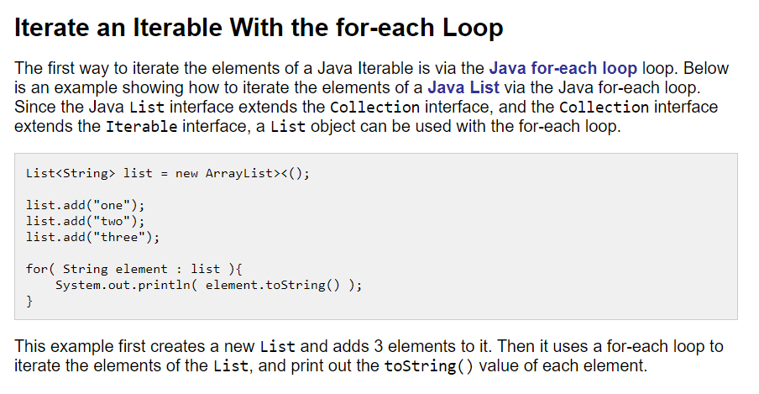

Slide 16
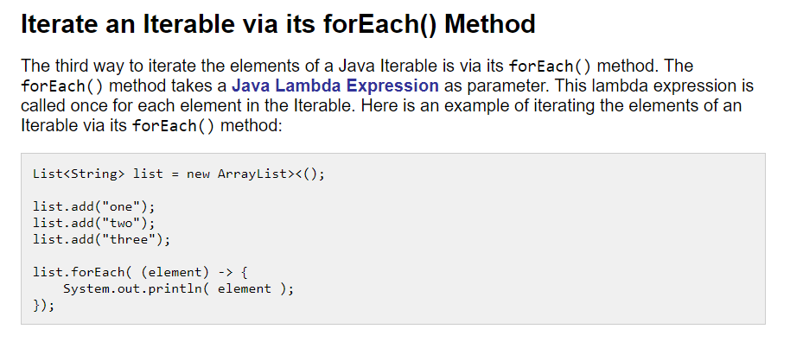

Slide 17
